Slide 2

CSE312 Electronic Design Automation
ATM - based bank system
Presented to : Dr. Eman El Mandouh
Supervised by: Eng. Kareem Waseem

Slide 3
Presented by
Team 13
Ahmed Nezar Ahmed
21P0025
Kirollos Ehab Magdy
21P0006
AbdulRahman Hesham Kamel
21P0153
Yasmina Nasser Hammam
21P0211
Farida Waleed Fakhry
21P0167
Monica Hany Makram
21P0173
Patrick Ramez Eskander
21P0180

Slide 4
Agenda
Finite State Machine Diagram
01
A diagram showing the transitions between different states.
Reference model
02
Using python for comparing results.
Modules
03
Code snippets of the implemented modules.
Testing and verification
04
Test bench, verification plan and verification results.

Slide 5
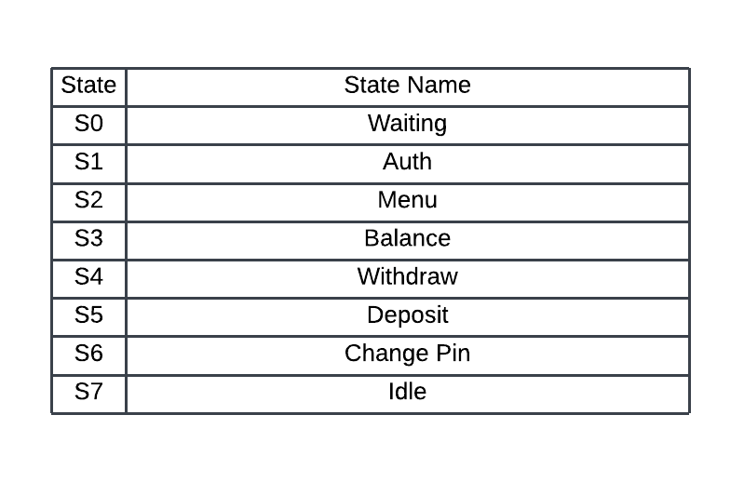
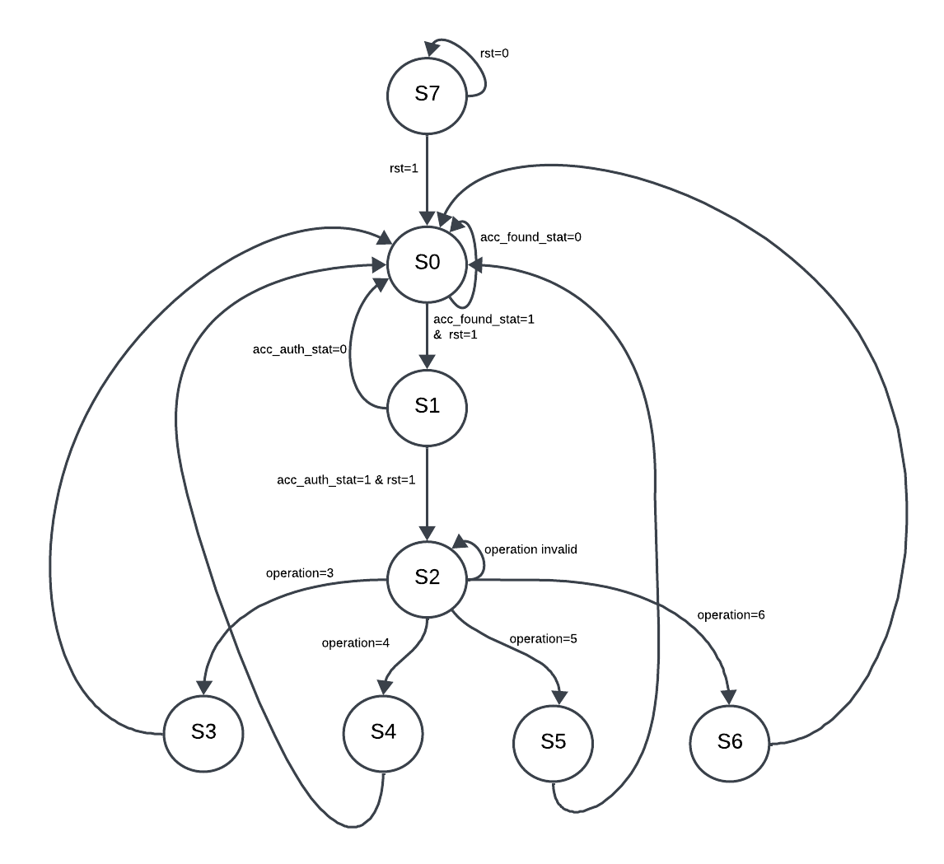
Finite State Machine Diagram
01
A diagram showing the transitions between different states.

Slide 6
REFERENCE MODEL
Using python for comparing results.

Slide 7
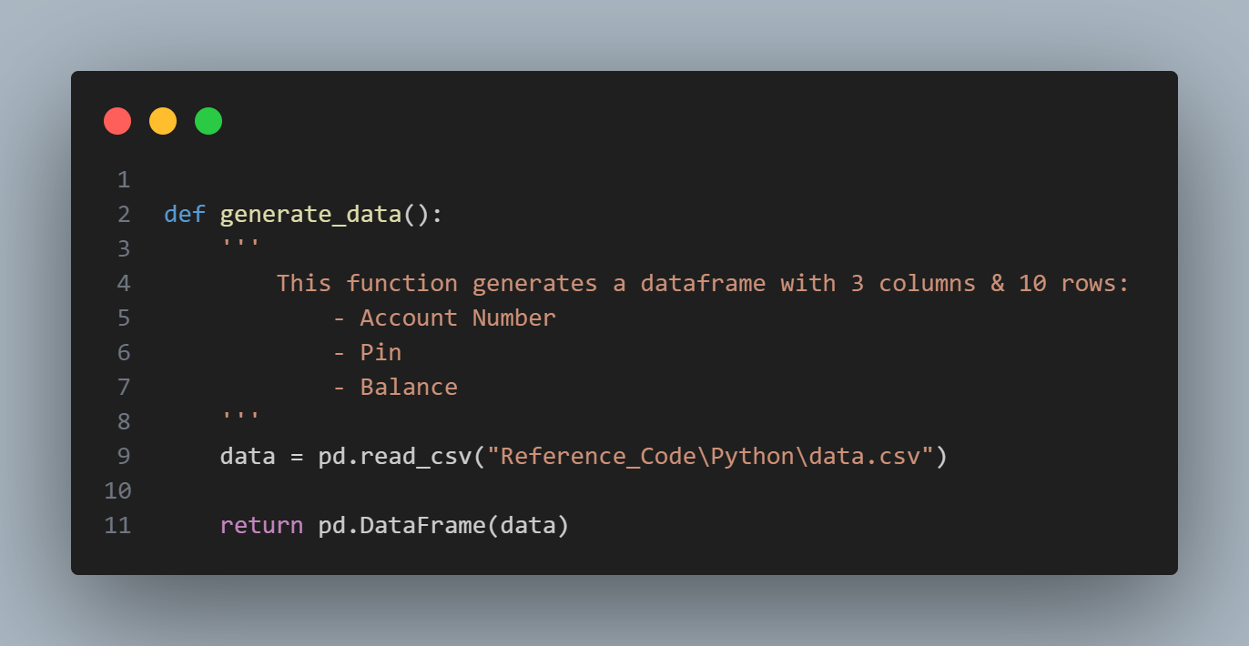
REFERENCE MODEL
02
Using python for comparing results.
Reading data from csv file :

Slide 8
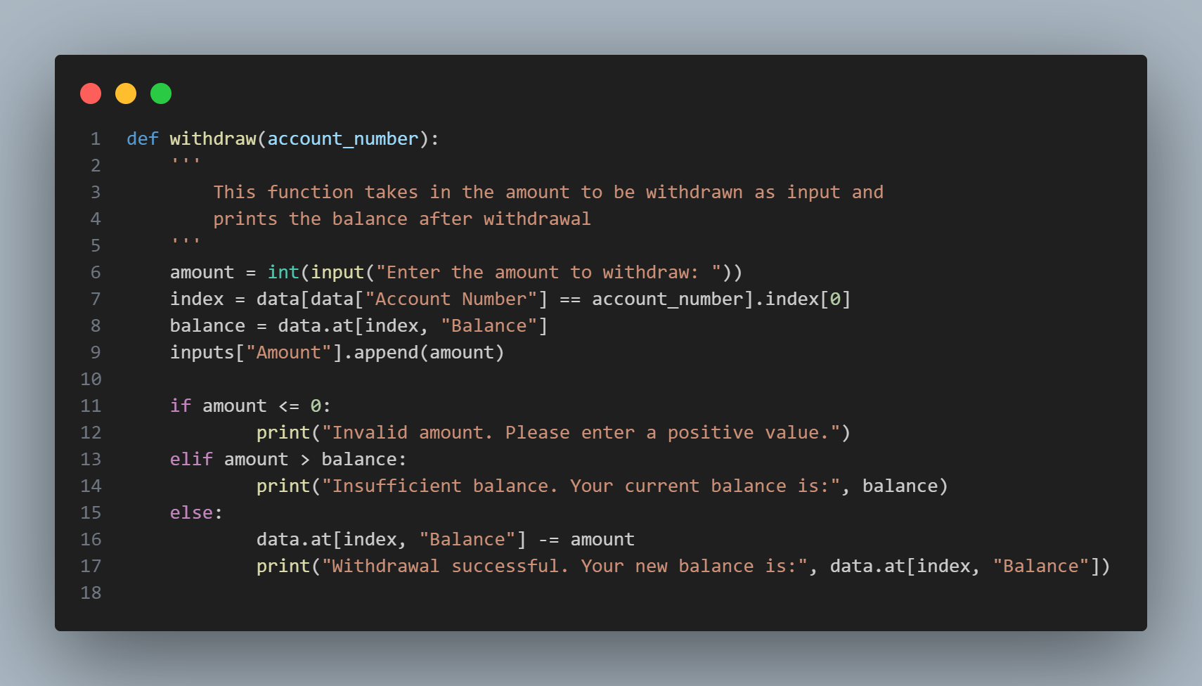
REFERENCE MODEL
02
Using python for comparing results.
Function withdraw :

Slide 9
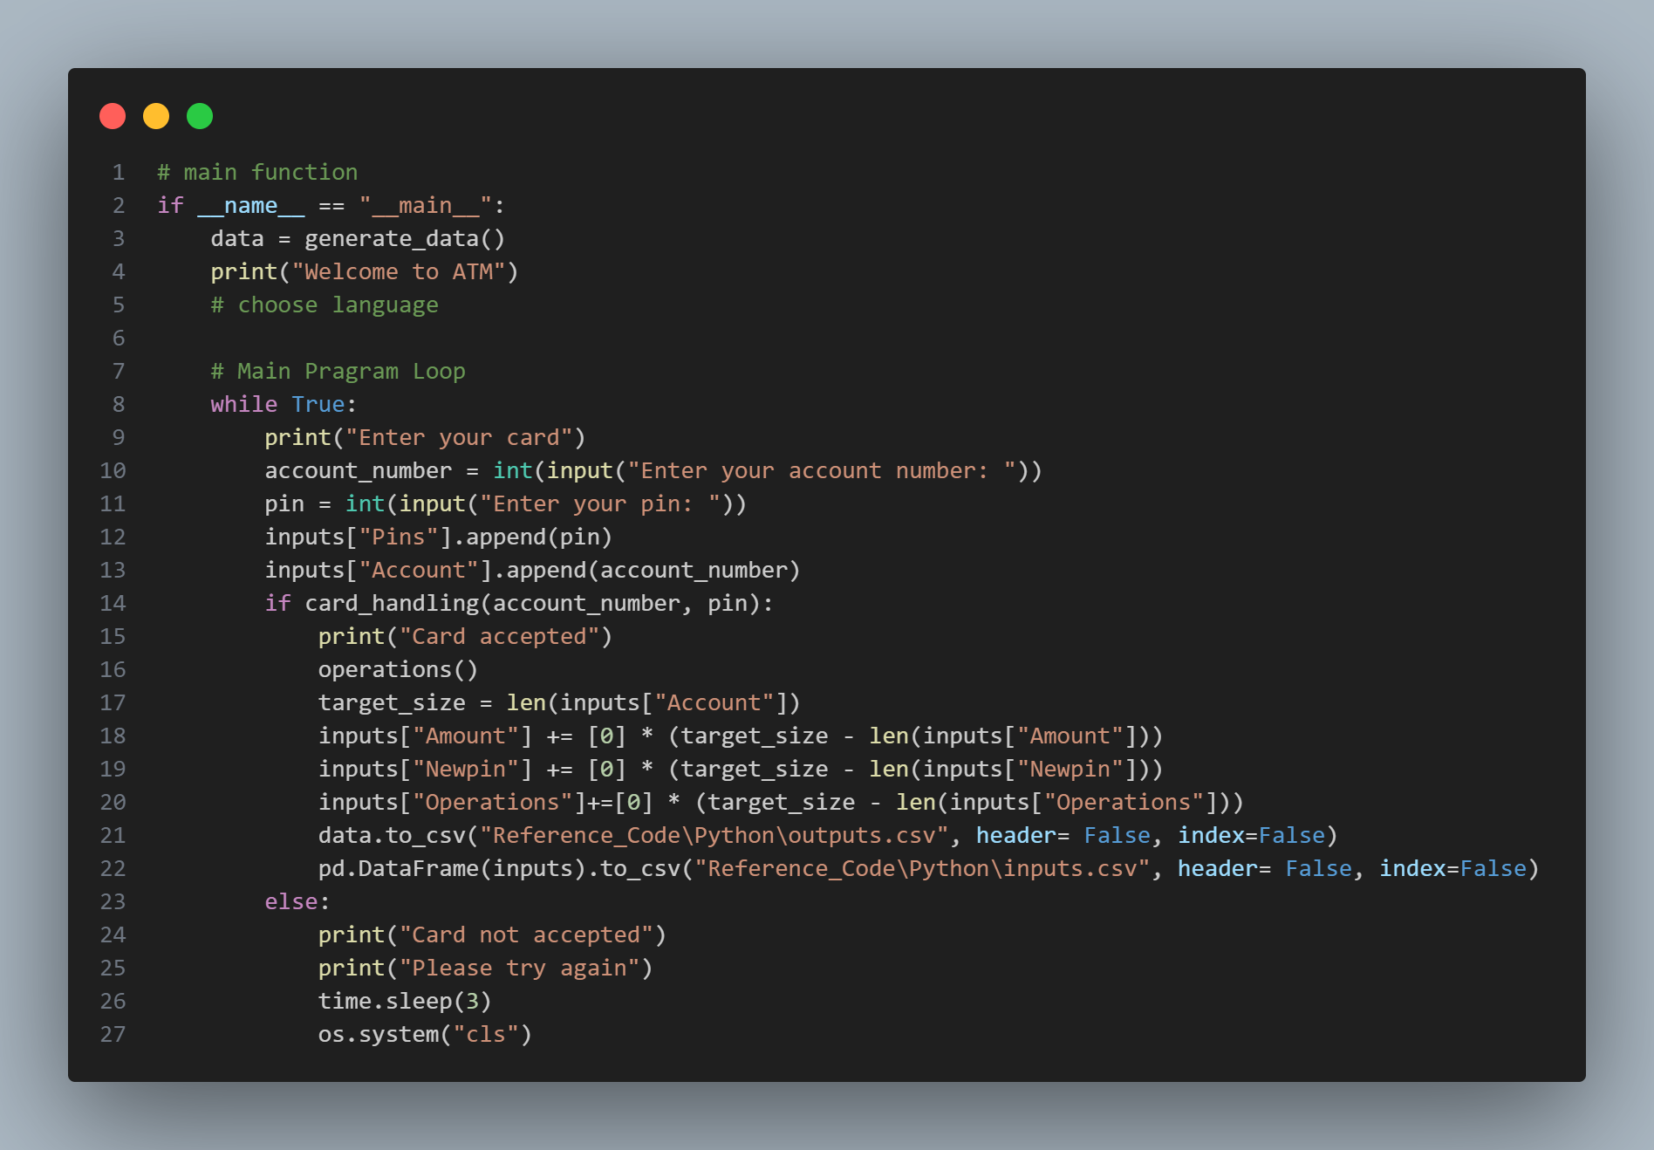
REFERENCE MODEL
02
Using python for comparing results.
Main :
Storing inputs and outputs in csv files for later analysis

Slide 10
Modules
Code snippets of the implemented modules

Slide 11
Modules
03
Code snippets of the implemented modules.
ATM

Slide 12
Modules
03
Code snippets of the implemented modules.
ATM
AUTH

Slide 13
Modules
03
Code snippets of the implemented modules.
ATM
AUTH
TASKS

Slide 14
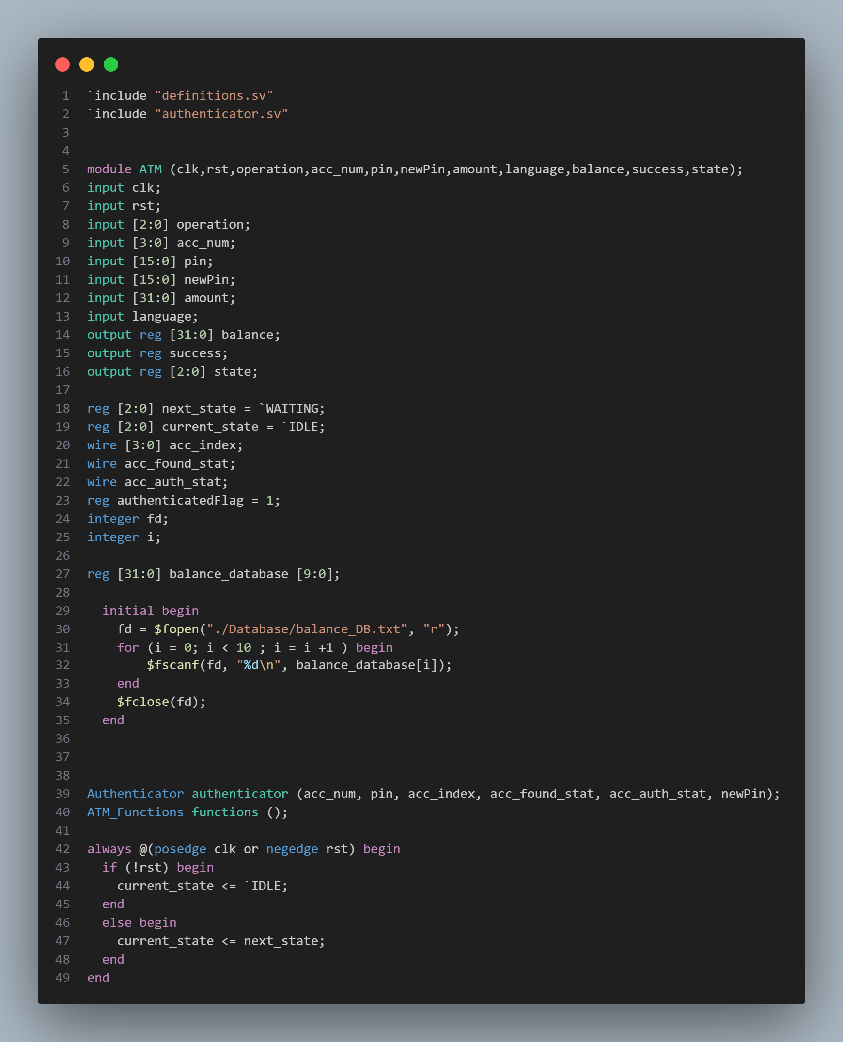
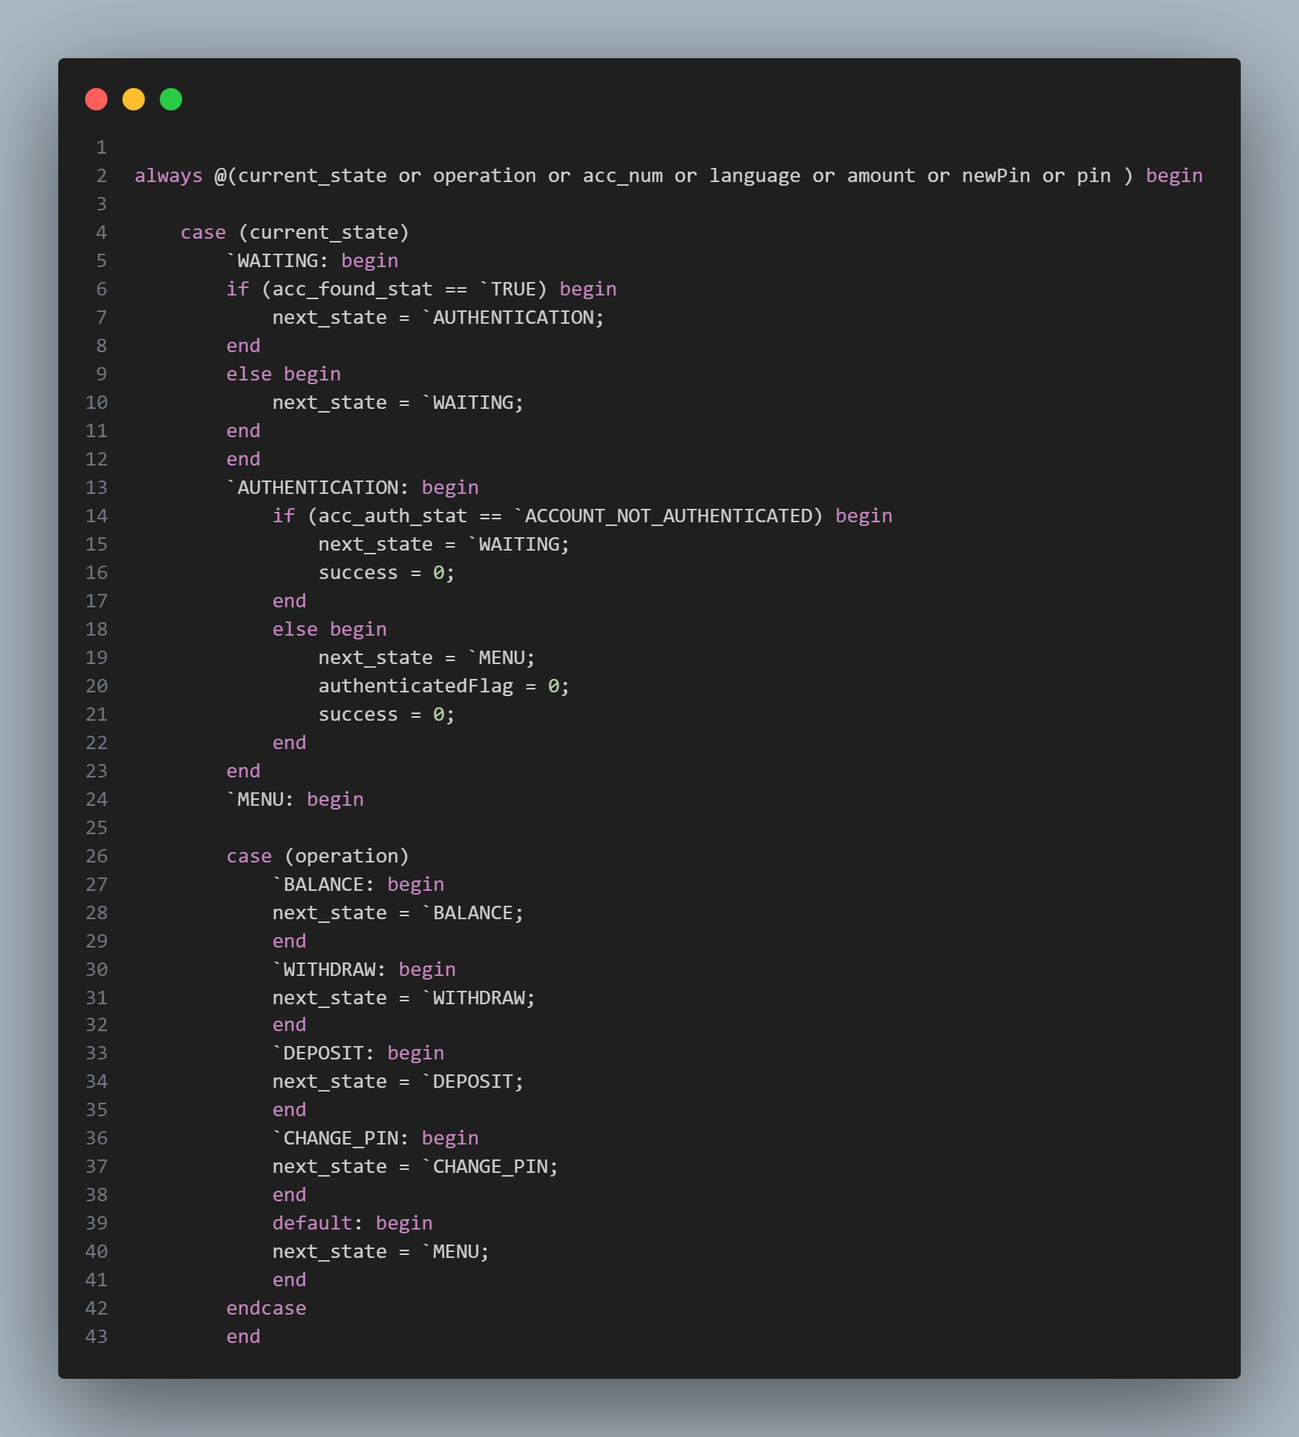
ATM
03
Code snippets of the implemented modules.

Slide 15
Modules
03
Code snippets of the implemented modules.
ATM
AUTH
TASKS

Slide 16
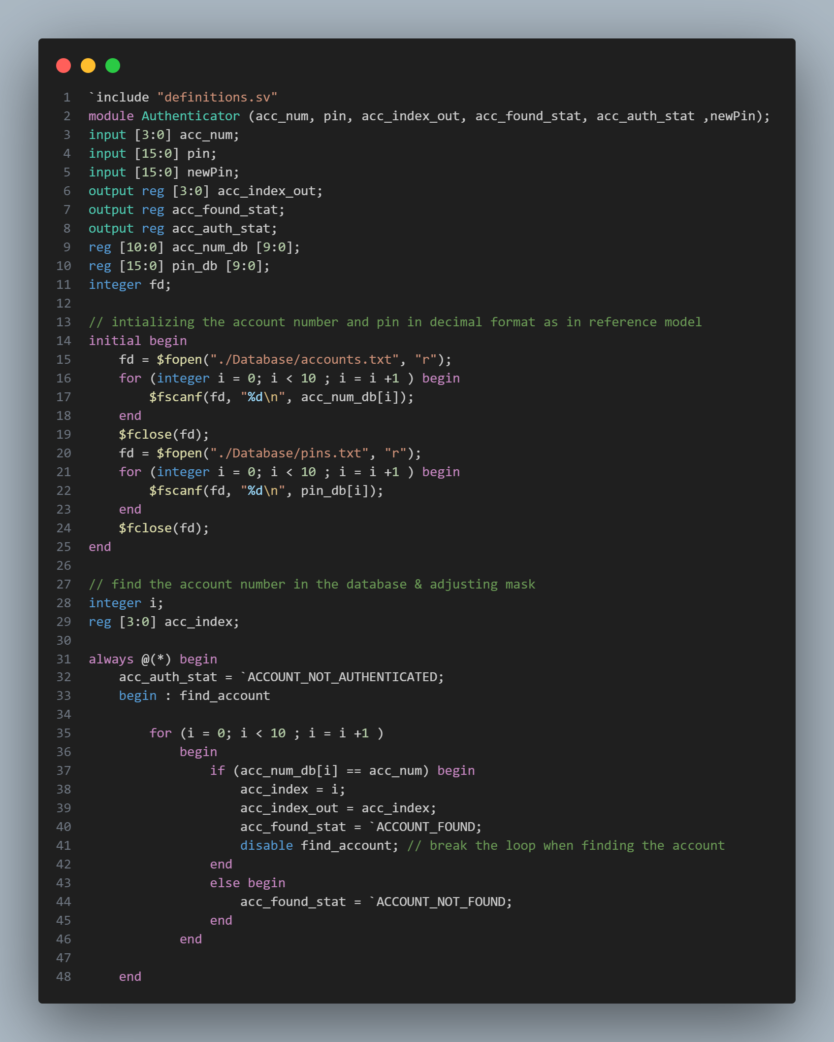
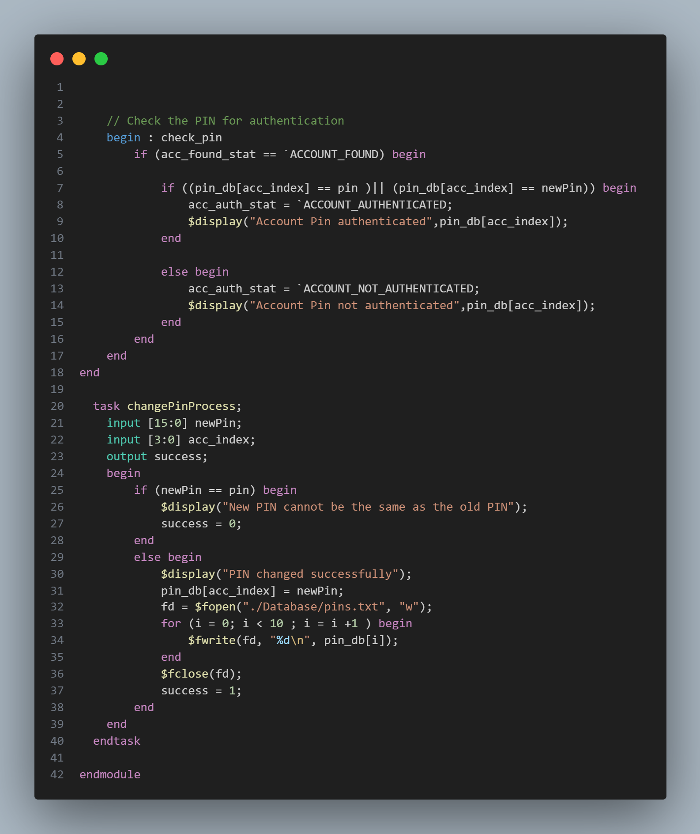
AUTH
ENTICATOR
03
Code snippets of the implemented modules.

Slide 17
Modules
03
Code snippets of the implemented modules.
ATM
AUTH
TASKS

Slide 18
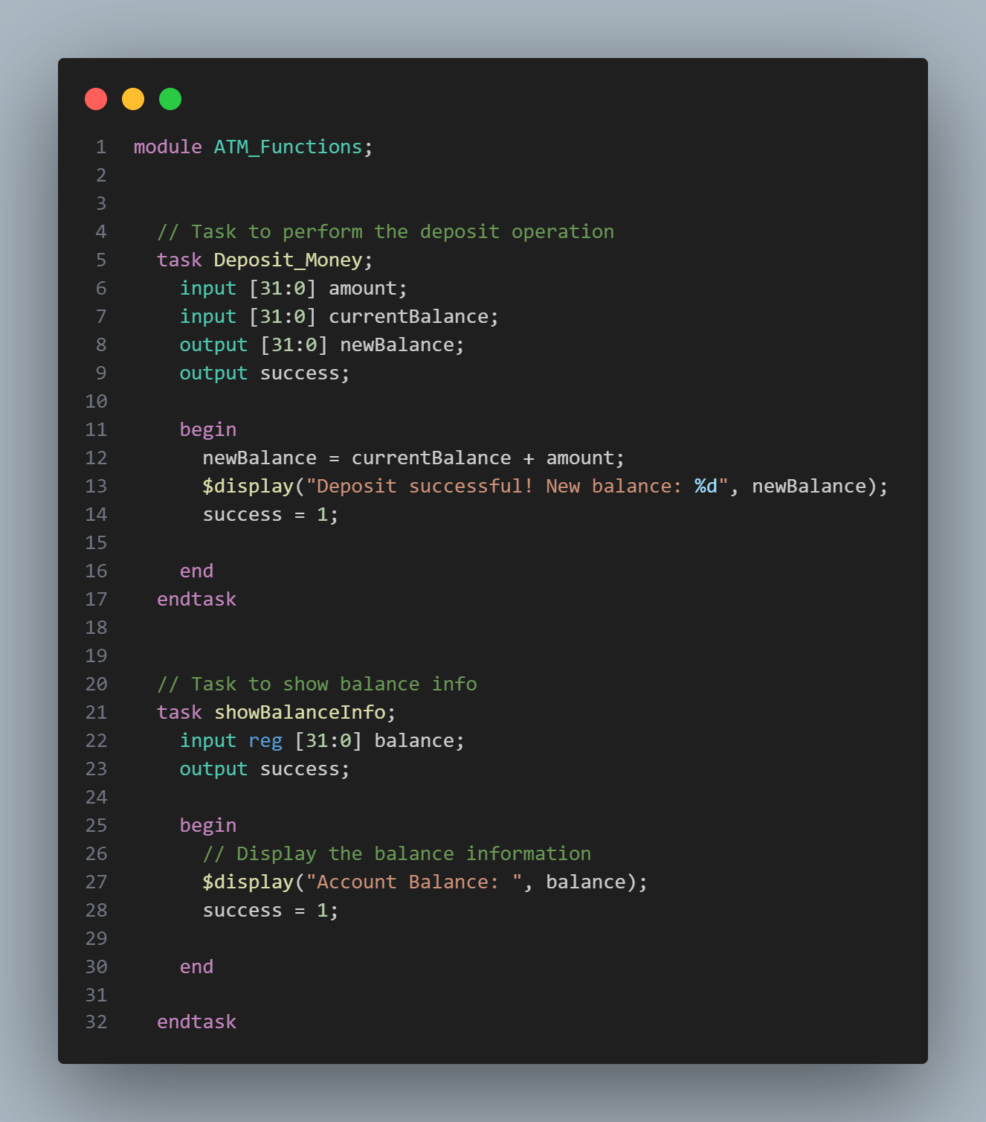
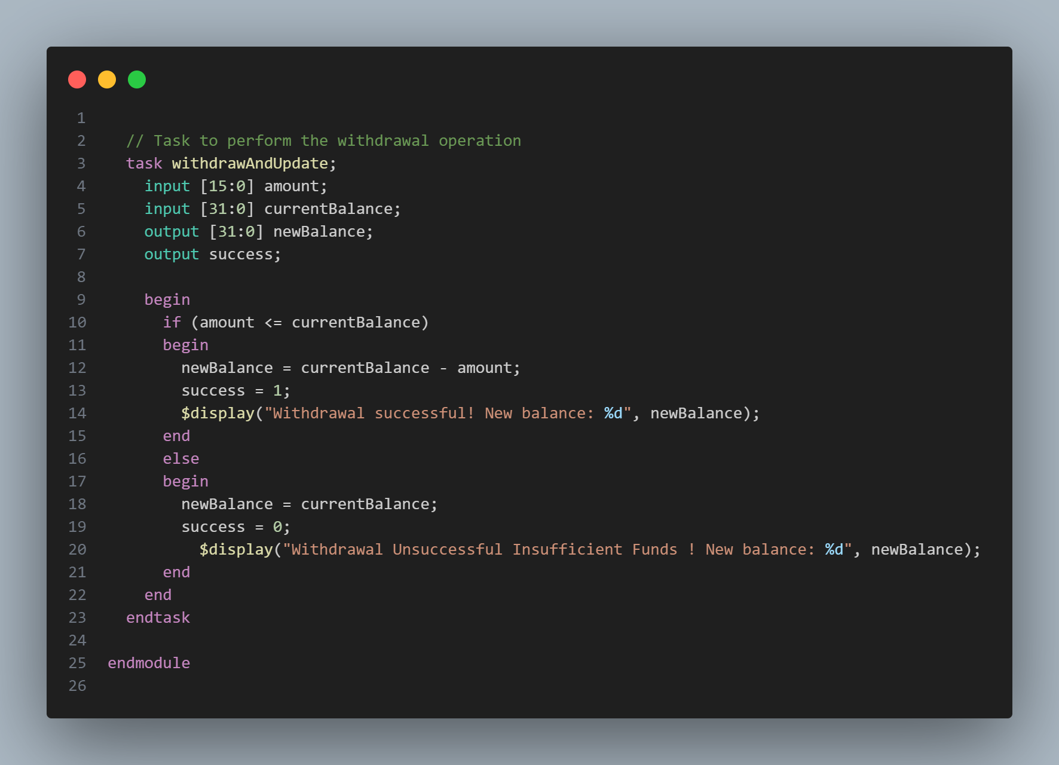
TASKS
03
Code snippets of the implemented modules.

Slide 19
RANDOMIZED
ASSERTION
TESTING

Slide 20
RANDOMIZED
ASSERTION
DERIVED
TESTING

Slide 21
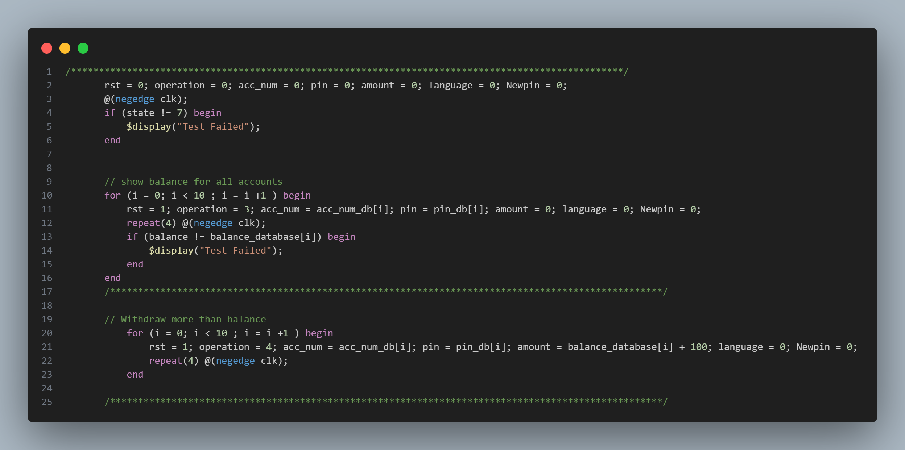
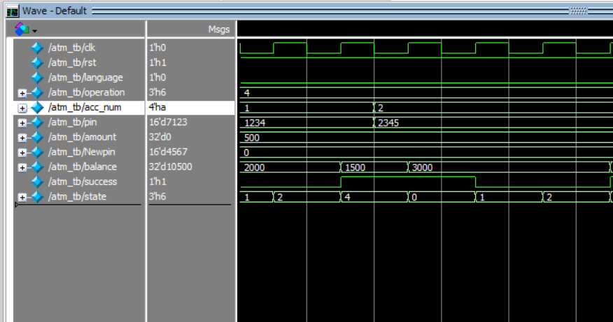
DERIVED

Slide 22
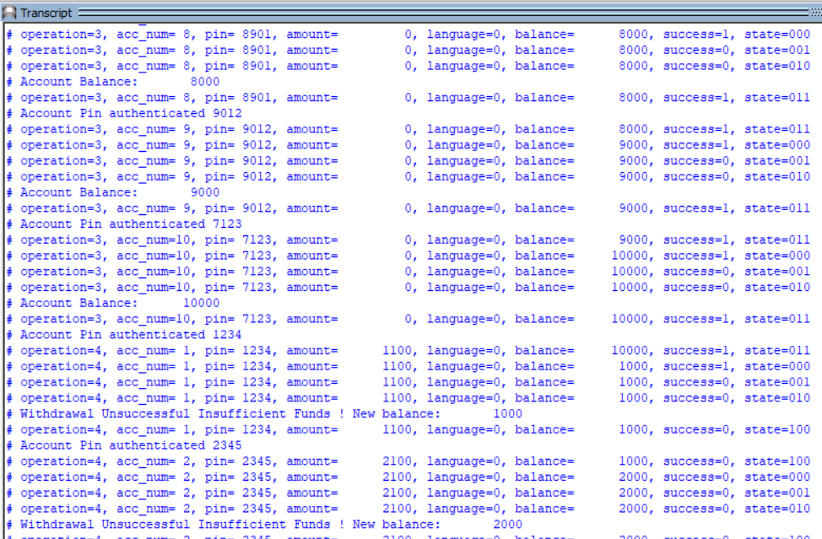
DERIVED

Slide 23
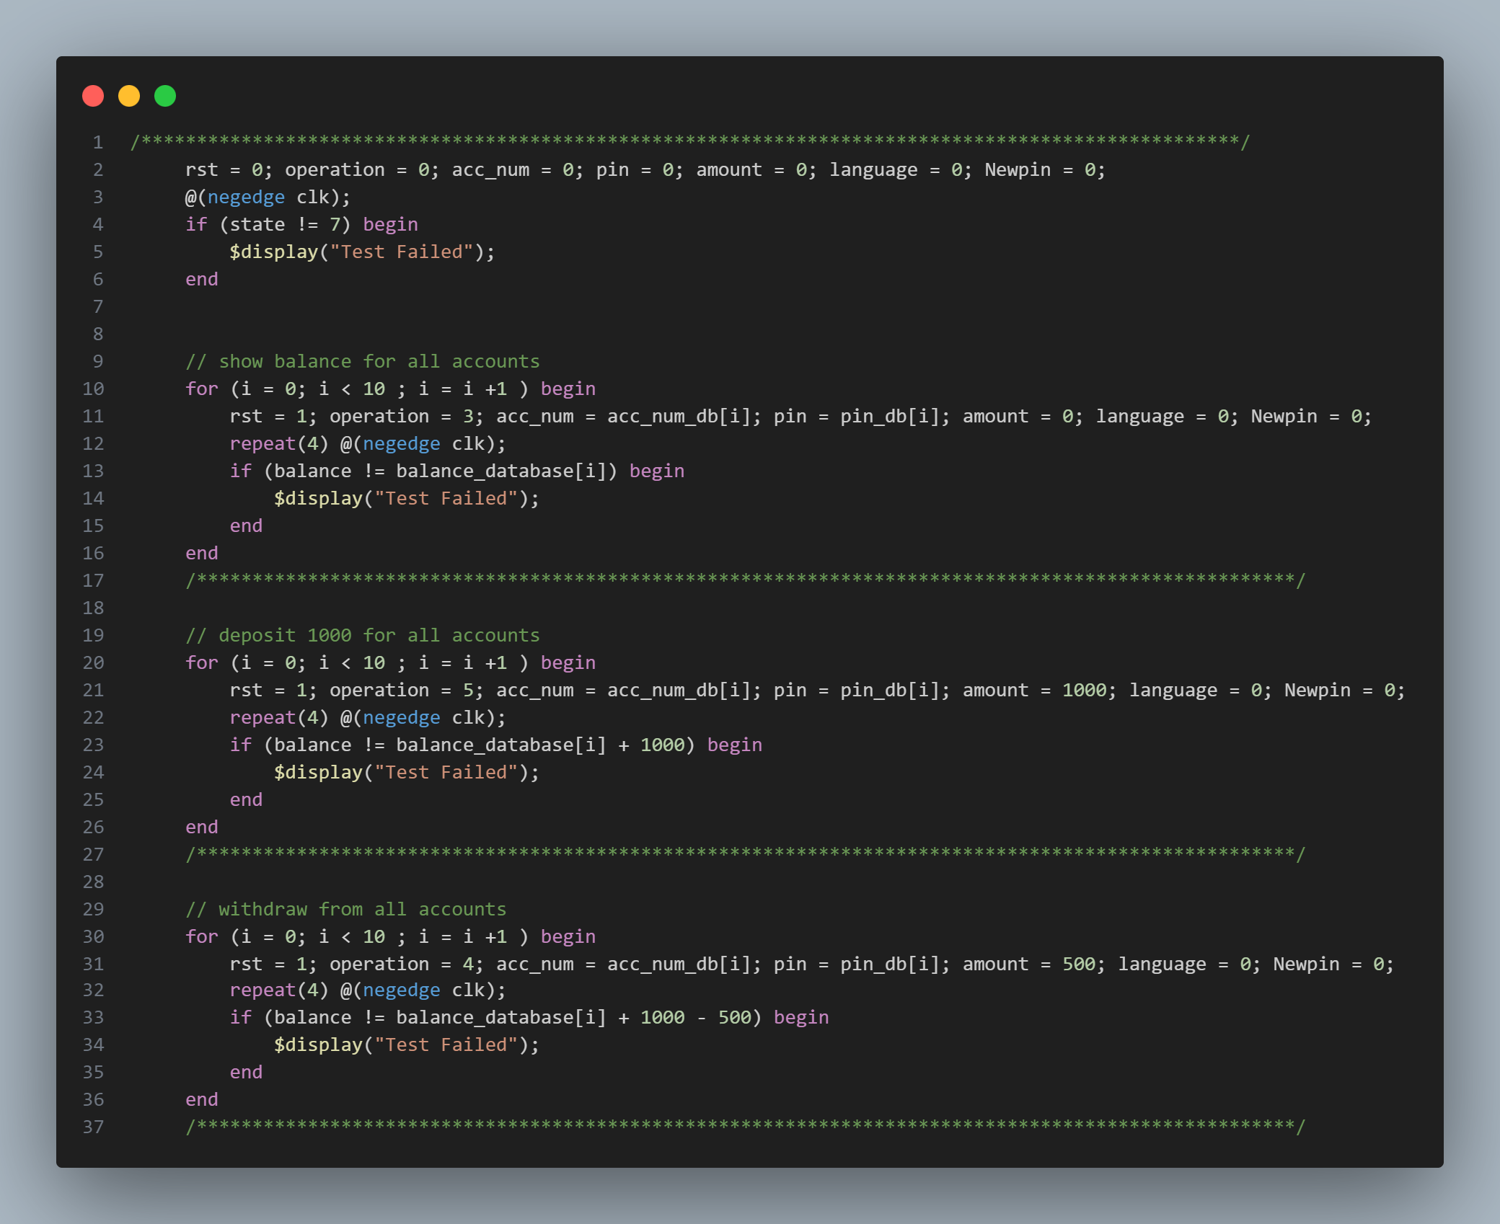
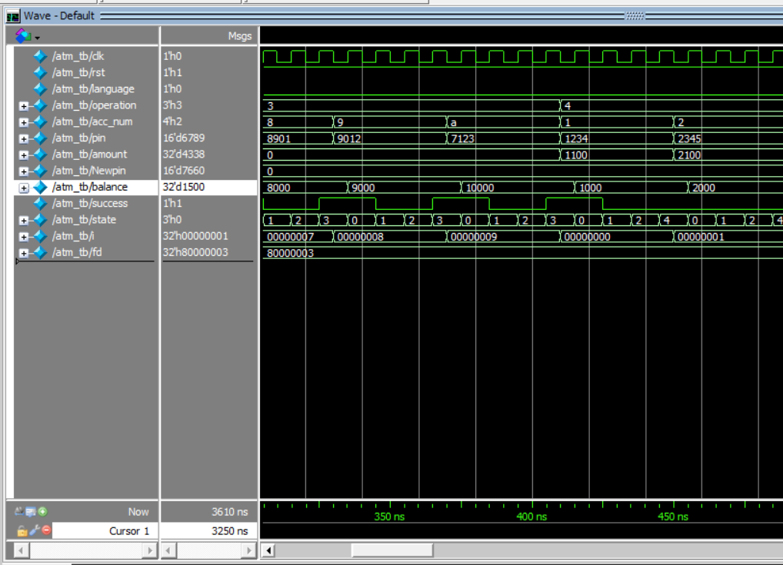
DERIVED

Slide 24
RANDOMIZED

Slide 25
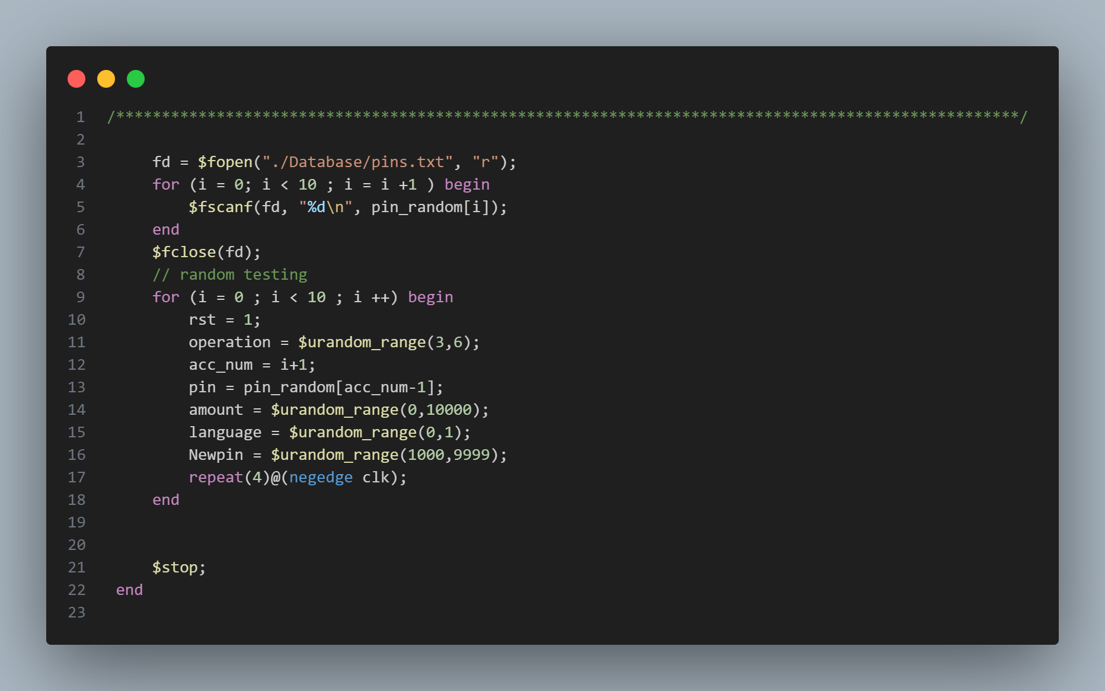
RANDOMIZED

Slide 26
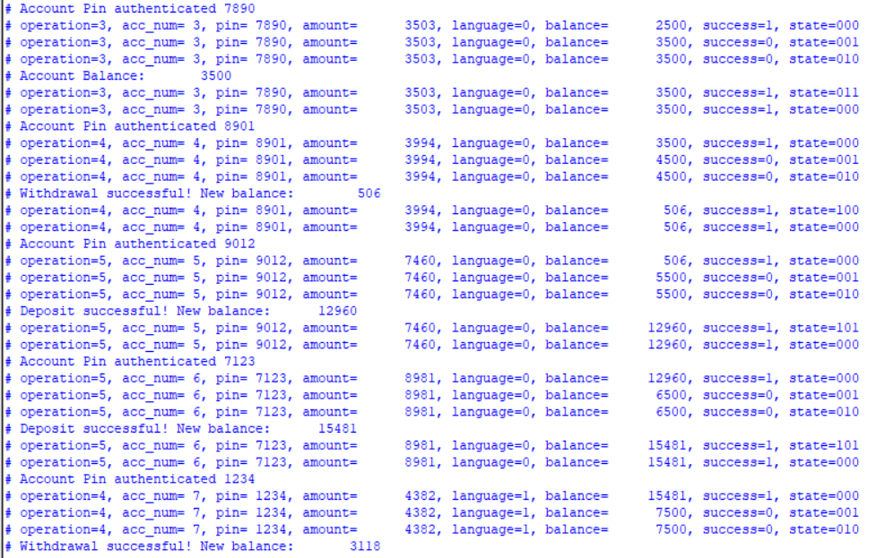
RANDOMIZED

Slide 27
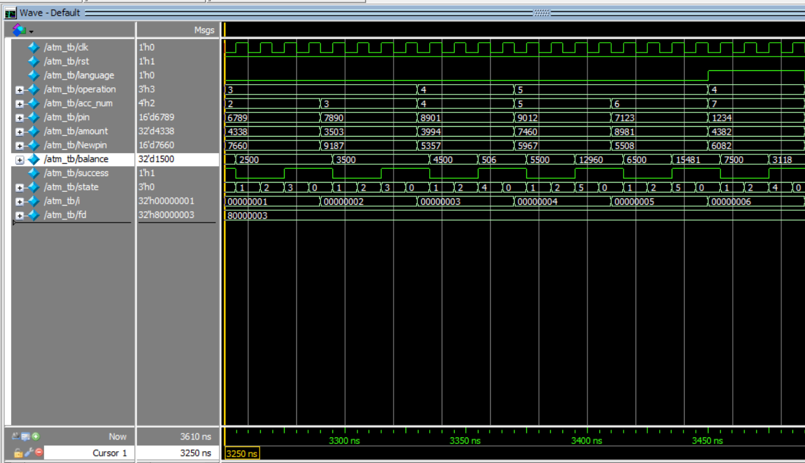
RANDOMIZED

Slide 28
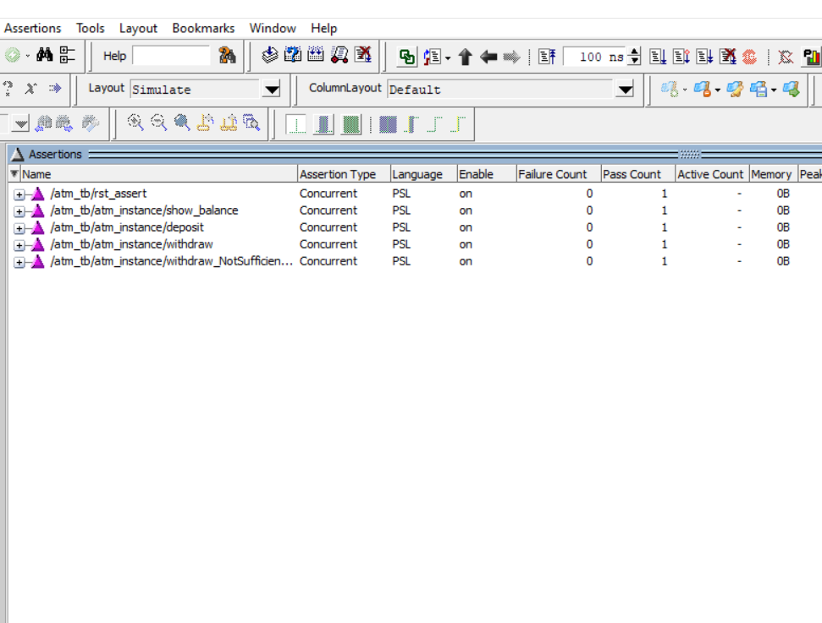
// psl show_balance: assert always((state == 2 && operation == 3) -> next(balance == balance_database[prev(acc_index)] )) @(posedge clk);
// psl deposit: assert always((state == 2 && operation ==5) -> next (balance == (prev(balance) + prev(amount)))) @(posedge clk);
// psl withdraw: assert always((state == 2 && operation ==4) -> next (balance == (prev(balance) - prev(amount)))) @(posedge clk);4
// psl rst_assert: assert always((rst == 0) -> next (state == 7)) @(posedge clk);
ASSERTION

Slide 29
// psl show_balance: assert always((state == 2 && operation == 3) -> next(balance == balance_database[prev(acc_index)] )) @(posedge clk);
// psl deposit: assert always((state == 2 && operation ==5) -> next (balance == (prev(balance) + prev(amount)))) @(posedge clk);
// psl withdraw: assert always((state == 2 && operation ==4) -> next (balance == (prev(balance) - prev(amount)))) @(posedge clk);4
// psl rst_assert: assert always((rst == 0) -> next (state == 7)) @(posedge clk);
ASSERTION

Slide 30
// psl show_balance: assert always((state == 2 && operation == 3) -> next(balance == balance_database[prev(acc_index)] )) @(posedge clk);
// psl deposit: assert always((state == 2 && operation ==5) -> next (balance == (prev(balance) + prev(amount)))) @(posedge clk);
// psl withdraw: assert always((state == 2 && operation ==4) -> next (balance == (prev(balance) - prev(amount)))) @(posedge clk);4
// psl rst_assert: assert always((rst == 0) -> next (state == 7)) @(posedge clk);
ASSERTION

Slide 31
COMPARING OUTPUTS
Comparing reference model and Verilog design outputs by applying same input file

Slide 32
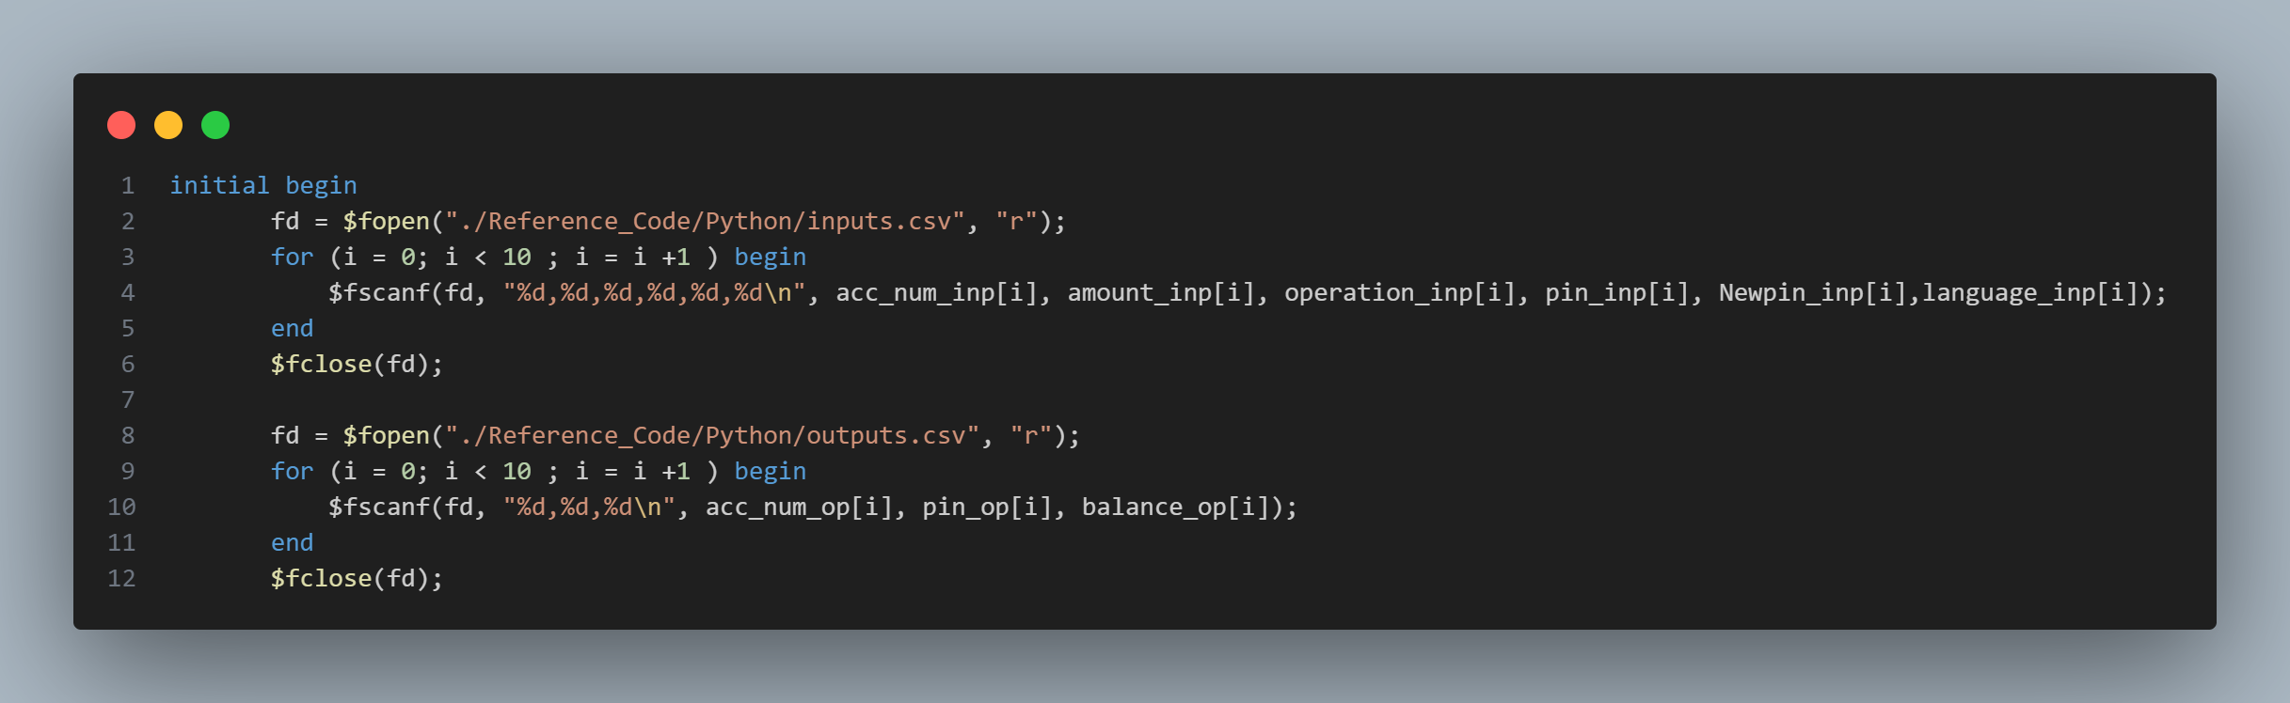
CMP MODULE
Reading inputs and expected outputs csv files we got from the reference model and putting them into registers:

Slide 33
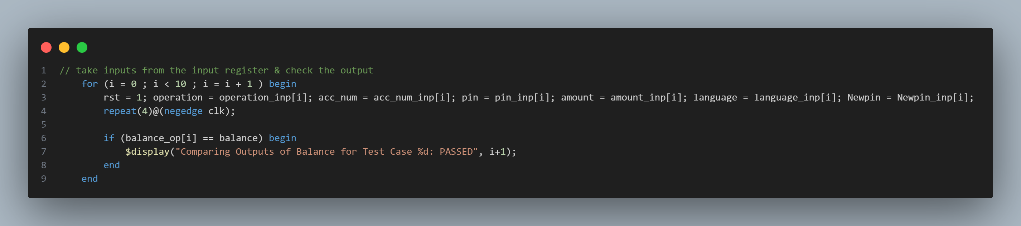
CMP MODULE
Comparing Balance Outputs:

Slide 34
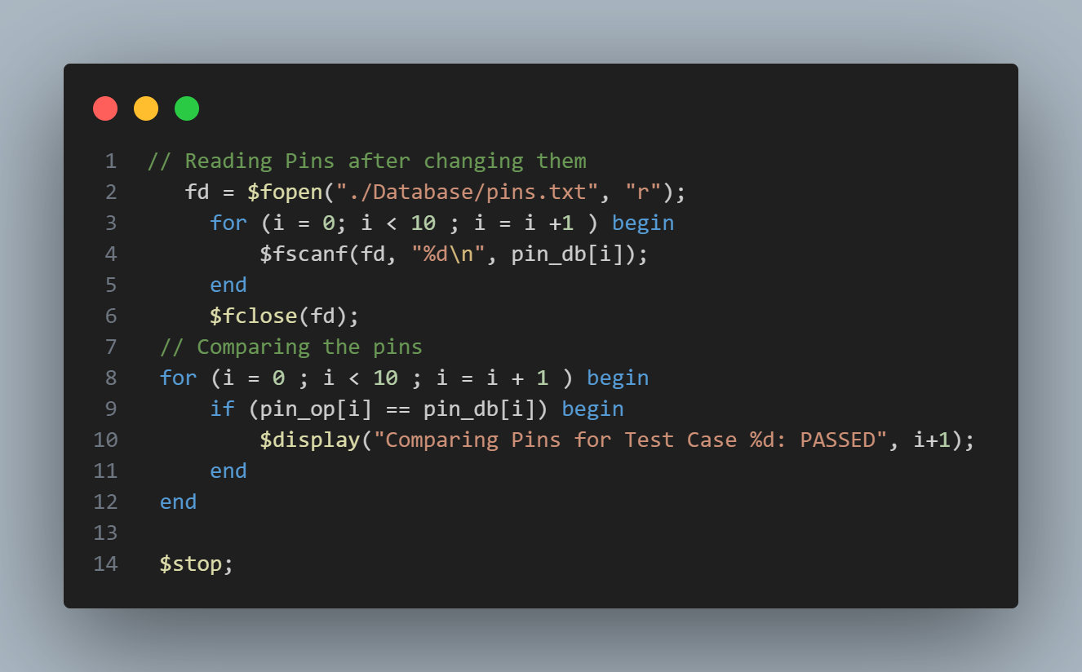
CMP MODULE
Comparing PINs:

Slide 35
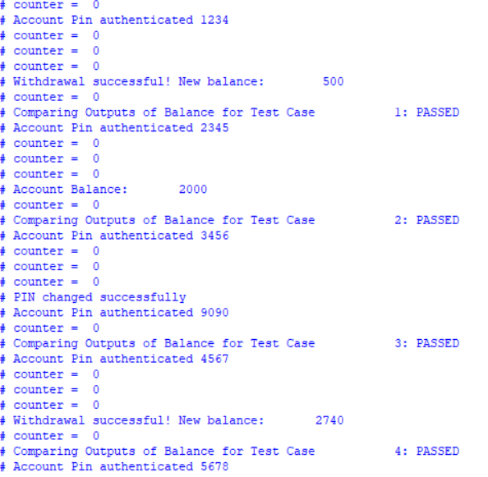
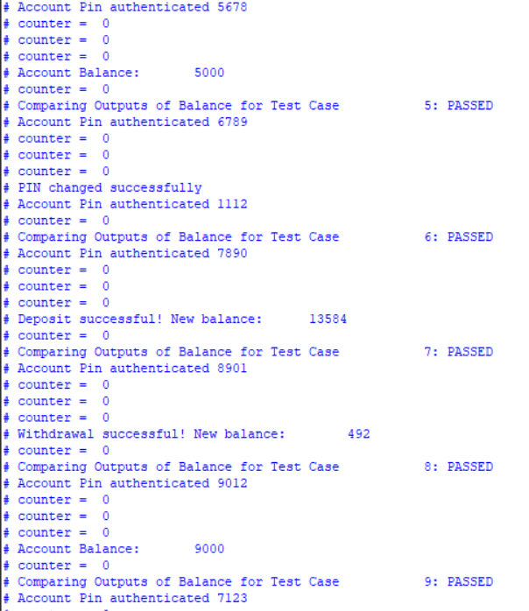
CMP MODULE
Comparing Balance Result :

Slide 36
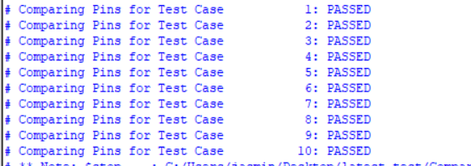
CMP MODULE
Comparing PINs Result :

Slide 37
Sync & Succeed

Slide 38




Apps that Power our Communication

Slide 39
Apps that Power our Communication
NOTION
GITHUB
DISCORD
WHATSAPP

Slide 40
Apps that Power our Communication
Our Repository :
GITHUB
https://github.com/Ahmed-Nezar/ATM_Verilog_Project

Slide 41
THANK YOU

